Slide 1
NFC Pedometer & Location Based Game
Nakayama Angelica

Slide 2
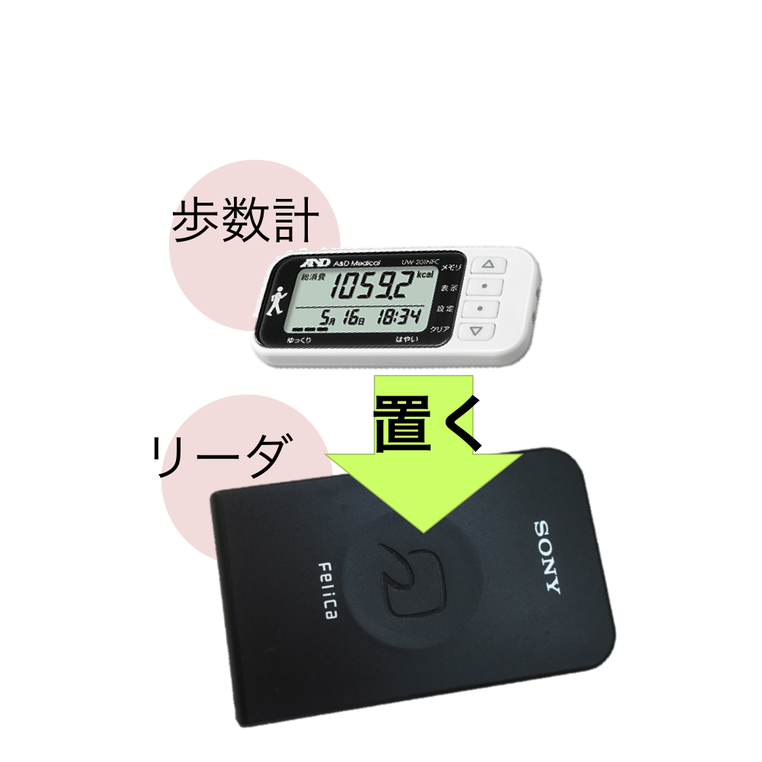
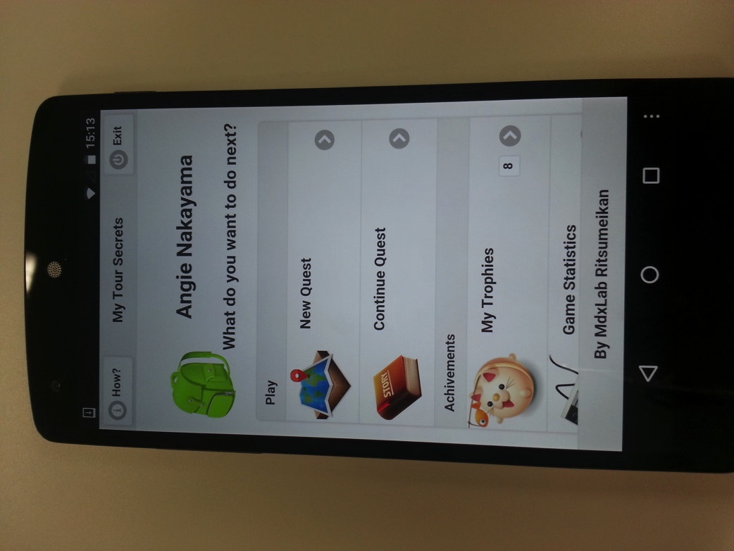
NFC Pedometer
Location Based Game
NFC Pedometer to integrate with Tekupeko project
LBG for tourism and sightseeing

Slide 3

NFC Pedometer for Tekupeko walking project
Tekupeko is a project for making people walk more using mobile technologies (smartphones).
This project was developed in Multimedia Experience Laboratory (by Suzuki san and Wakao san) it was used last year (and also this year) on a walking for health event.
Android and iPhone app already developed and in phase of redesign and improvement.
There is also a webpage where you can register and see your progress, make teams, etc.

Slide 4

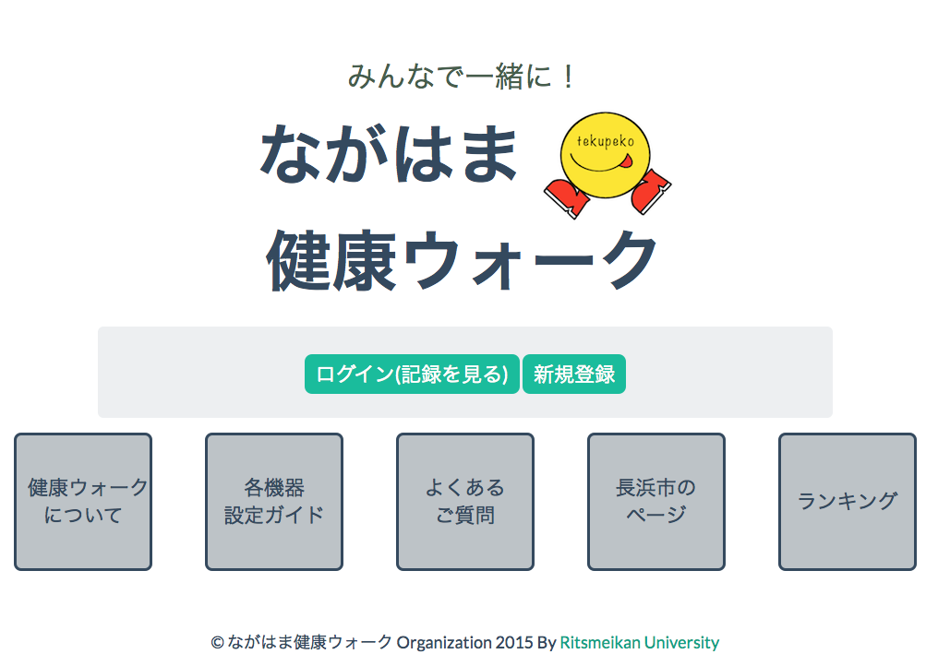
Web page and event promotion

Slide 5

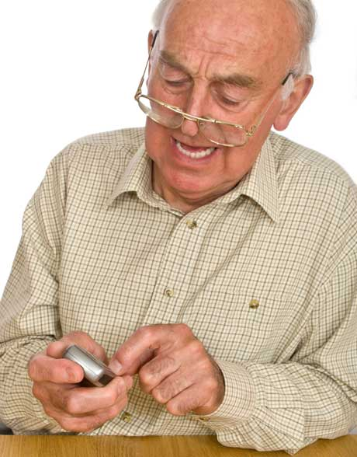
But what about people without smartphones?
Older people, kids, etc. How can they participate on this event????

Slide 6
The solution: NFC Pedometer
By using a NFC pedometer we can make this people to enter the event.
No need to buy a expensive device and learn complicated things to use it.
Just carry the device on their pocket and go to registration point once a while.
Using NFC technology we can transfer walking data from pedometer to the event website.

Slide 7
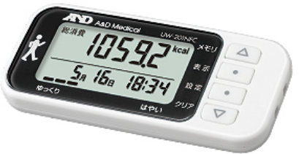
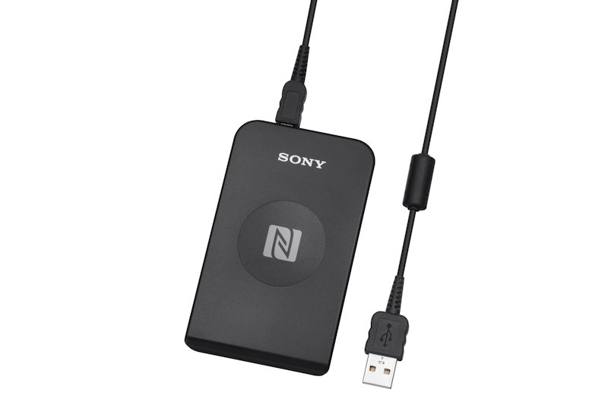
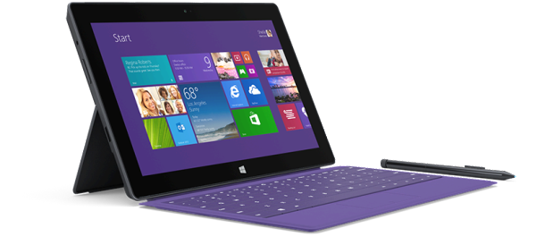
Hardware
NFC Pedometer
A&D Medical UW-201NFC
NFC reader
Sony RC-S380
PC
Windows Surface Pro 3

Slide 8
Design & Technology
Diagrama de Disenio inicial de sugiyama san
Tecnologias a usar Python, PyNFCread, github
Que es NFC Type 3 Dynamic Tag (sony reader Felica)
Implementacion inicial y problemas que se tuvieron
Usando libreria de sony y nuevo disenio
Pantallas

Slide 9
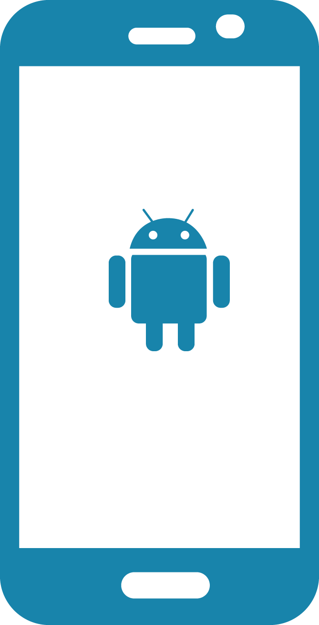




Django
Tekupeko server
Pedometer
Reader
Android
Tekupeko app
Moves Relay App
GIT
Server
Moves
Server
YAML
File
PC app
iOS
Moves app
Android
Moves app

Slide 10
LBG for tourism and sightseeing
https://en.wikipedia.org/wiki/Location-based_game
http://everybodywalk.org/documentary/

Slide 11
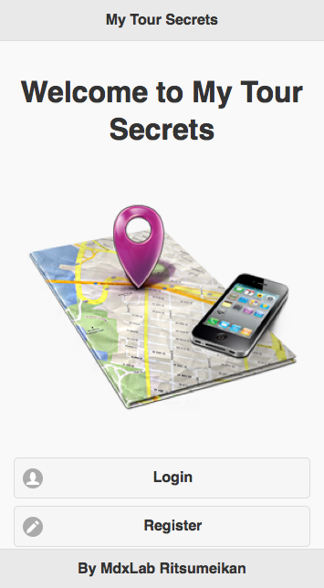
Welcome and logging
Pantallas y video y/o demo

Slide 12
Design &Technology
HTML 5
Phonegap
Jquery & Jquery Moblile
Phonegap Build
Google Maps appi for JS

